Slide 1
ICS 141 – Programming With Objects
Lecture 3 – Robert Jahn
Based on the slides of Dr. Daniel Liang

Slide 2
Schedule
Announcements/Reminders 6:00 – 6:05
Review Session – Quiz #1/Exercise #1/Assignment #1 6:05 – 6:20
Quiz #2 6:20 – 6:40
Methods 6:40 – 7:10
Exercise 3(a) + Break 7:10 – 7:25
Method Overloading 7:25 – 7:35
Arrays 7:35 – 8:00
Exercise 3(b) 8:00 – 8:10
Begin 2D Arrays 8:10 – 8:30

Slide 3
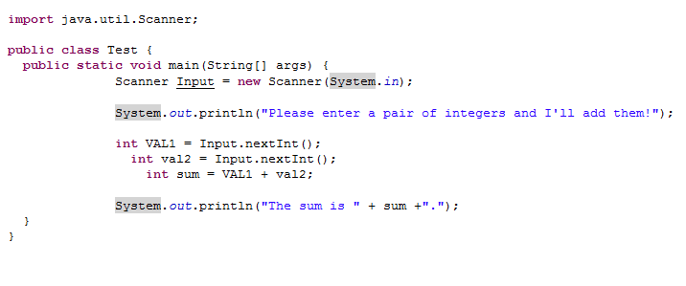
Exercise Review

Slide 4
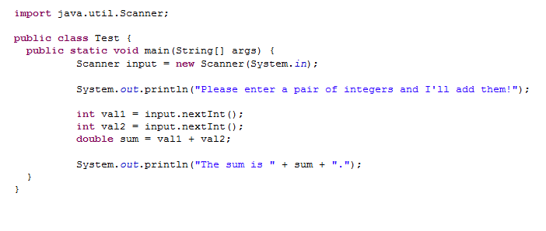
Exercise Review

Slide 5
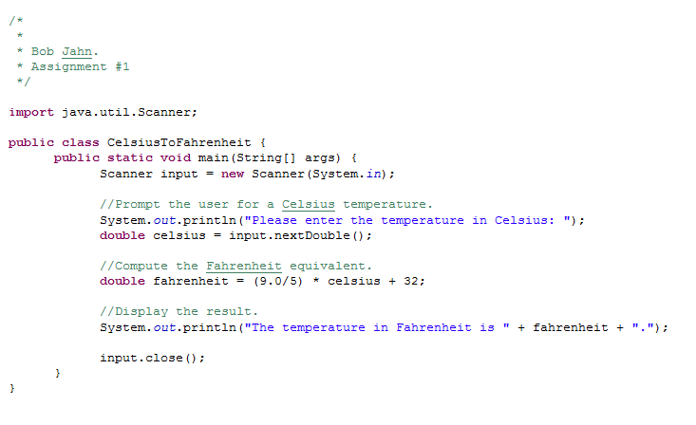
Assignment Review

Slide 6
Methods

Slide 7
Opening Problem - Motivations
Find the sum of integers from 1 to 10, from 20 to 30, and from 35 to 45, respectively.

Slide 8
Problem
int sum = 0;
for (int i = 1; i <= 10; i++)
sum += i;
System.out.println("Sum from 1 to 10 is " + sum);
sum = 0;
for (int i = 20; i <= 30; i++)
sum += i;
System.out.println("Sum from 20 to 30 is " + sum);
sum = 0;
for (int i = 35; i <= 45; i++)
sum += i;
System.out.println("Sum from 35 to 45 is " + sum);

Slide 9
Problem
int sum = 0;
for (int i = 1; i <= 10; i++)
sum += i;
System.out.println("Sum from 1 to 10 is " + sum);
sum = 0;
for (int i = 20; i <= 30; i++)
sum += i;
System.out.println("Sum from 20 to 30 is " + sum);
sum = 0;
for (int i = 35; i <= 45; i++)
sum += i;
System.out.println("Sum from 35 to 45 is " + sum);

Slide 10
Solution
public static int sum(int i1, int i2) {
int sum = 0;
for (int i = i1; i <= i2; i++)
sum += i;
return sum;
}
public static void main(String[] args) {
System.out.println("Sum from 1 to 10 is " + sum(1, 10));
System.out.println("Sum from 20 to 30 is " + sum(20, 30));
System.out.println("Sum from 35 to 45 is " + sum(35, 45));
}

Slide 11
Defining Methods
A method is a collection of statements that are grouped together to perform an operation.

Slide 12
Method Signature
Method signature is the combination of the method name and the parameter list.

Slide 13
Formal Parameters
The variables defined in the method header are known as formal parameters.

Slide 14
Actual Parameters
When a method is invoked, you pass a value to the parameter. This value is referred to as actual parameter or argument.

Slide 15
Return Value Type
A method may return a value. The returnValueType is the data type of the value the method returns. If the method does not return a value, the returnValueType is the keyword void. For example, the returnValueType in the main method is void.

Slide 16
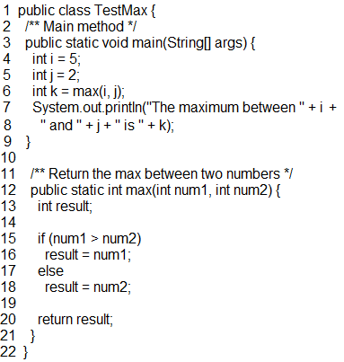
Calling Methods
Testing the max method
This program demonstrates calling a method max to return the largest of the int values

Slide 17
Calling Methods, cont.
animation

Slide 18
Trace Method Invocation
animation
i is now 5

Slide 19
Trace Method Invocation
animation
j is now 2

Slide 20
Trace Method Invocation
animation
invoke max(i, j)

Slide 21
Trace Method Invocation
animation
invoke max(i, j)
Pass the value of i to num1
Pass the value of j to num2

Slide 22
Trace Method Invocation
animation
declare variable result

Slide 23
Trace Method Invocation
animation
(num1 > num2) is true since num1 is 5 and num2 is 2

Slide 24
Trace Method Invocation
animation
result is now 5

Slide 25
Trace Method Invocation
animation
return result, which is 5

Slide 26
Trace Method Invocation
animation
return max(i, j) and assign the return value to k

Slide 27
Trace Method Invocation
animation
Execute the print statement

Slide 28
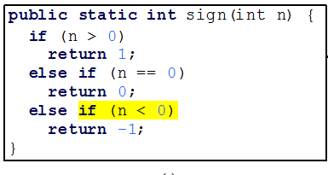
Good Code?

Slide 29
CAUTION
A return statement is required for a value-returning method. The method shown below in (a) is logically correct, but it has a compilation error because the Java compiler thinks it possible that this method does not return any value.
To fix this problem, delete if (n < 0) in (a), so that the compiler will see a return statement to be reached regardless of how the if statement is evaluated.

Slide 30
Reuse Methods from Other Classes
NOTE: One of the benefits of methods is for reuse. The max method can be invoked from any class besides TestMax. If you create a new class Test, you can invoke the max method using ClassName.methodName (e.g., TestMax.max).

Slide 31
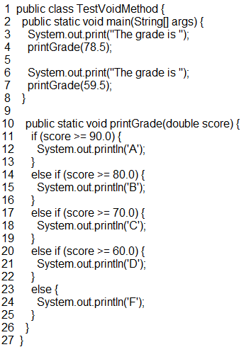
void Method Example
This type of method does not return a value. The method performs some actions.
Something to note here. If the method is void, we do not need to use the return keyword. However, we still can.

Slide 32
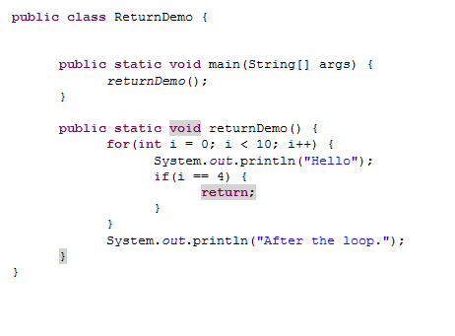
void Method Example
How many types will this print “hello”? Will it print “After the loop.”?
Return here will take us out of the method completely.
What would we use if we wanted to only jump out of the loop and not the entire method?

Slide 33
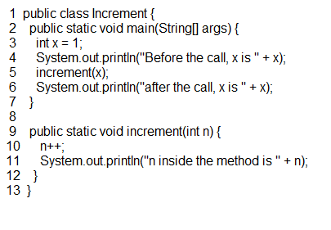
Pass by Value
Testing Pass by value.
This program demonstrates passing values to the methods.

Slide 34
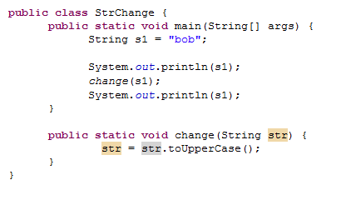
Pass by value vs pass by reference.
Coming from other languages, you may have heard of another passing scheme: pass by reference.
C++ for example
In java, technically speaking, we only ever perform pass-by-value.
This goes against the normal thinking that we use pass by reference whenever we pass a reference variable.
For example, this would not work as you’d expect. The String will not be capitalized within the main method. It will only be capitalized within the scope of the method.

Slide 35
Method Overloading
Java allows us to redefine methods with the same name. This is useful when we want to define a method that performs a very similar task to a pre-existing method, but differs in terms of the method signature.
For instance, say we have a method to add two double values. We can write another version of the method which accepts as input three parameters.
This is called overloading a method.
This occurs at compile time and the compiler chooses which method ‘fits’ best.
This ‘fitting’ is based on which method most closely matches the input parameters given in the call to the method.

Slide 36
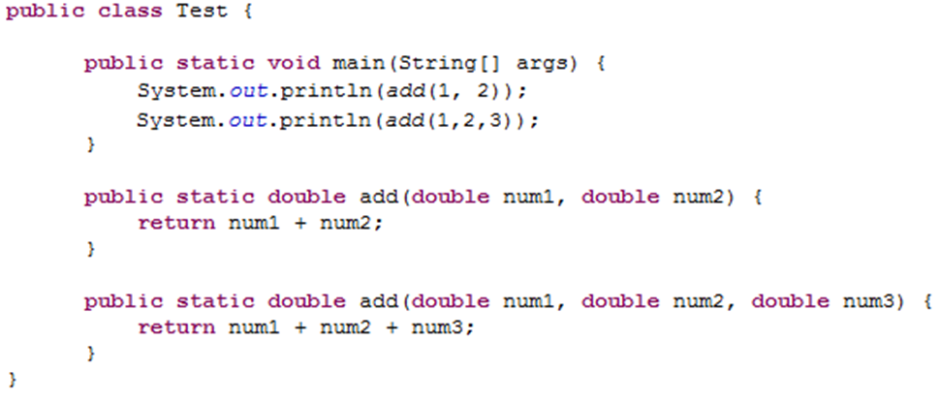
Method Overloading

Slide 37
Method Overloading
Some things to consider,
In order to properly overload a method, the signature must be different in one of two ways.
The amount of parameters must be different.
The type of one or more parameters must be different.
It is not overloading a method if we,
Change the return type. If we only change the return type, we will get a compiler error.
Change the name of the parameters. If we simply change the name of a parameter, without changing the actual type, this will also result in a compiler error.

Slide 38
Ambiguous Invocation
What if we have a pair of overloaded methods that have ambiguous input parameters? That is, the parameters are defined such that the compiler cannot decide which method fits best?
This is known as ambiguous invocation. This will actually cause a compiler error as the compiler cannot possibly pick one or the other.

Slide 39
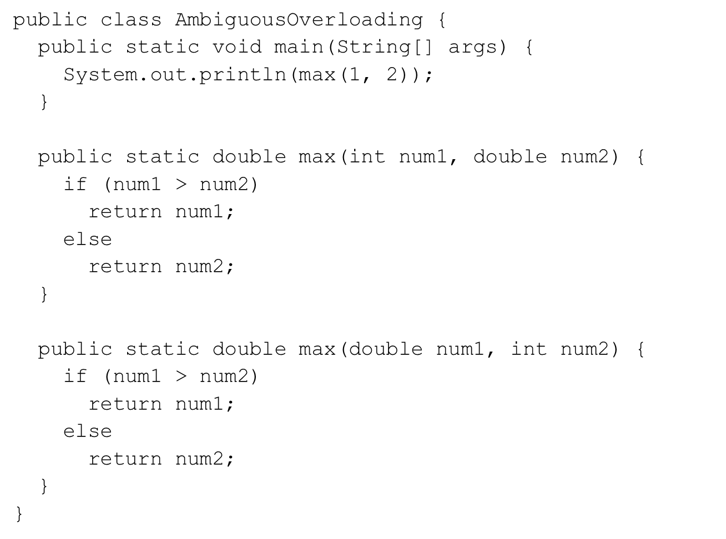
Ambiguous Invocation

Slide 40
Exercise 3a

Slide 41
Arrays

Slide 42
Introducing Arrays
Array is a data structure that represents a collection of the same types of data.

Slide 43
Declaring Array Variables
datatype[] arrayRefVar;
Example:
double[] myList;
datatype arrayRefVar[]; // This style is allowed, but //not preferred
Example:
double myList[];

Slide 44
Creating Arrays
arrayRefVar = new datatype[arraySize];
Example:
myList = new double[10];
myList[0] references the first element in the array.
myList[9] references the last element in the array.

Slide 45
Declaring and Creating in One Step
datatype[] arrayRefVar = new datatype[arraySize];
double[] myList = new double[10];
datatype arrayRefVar[] = new datatype[arraySize];
double myList[] = new double[10];

Slide 46
The Length of an Array
Once an array is created, its size is fixed. It cannot be changed. You can find its size using
arrayRefVar.length
For example,
myList.length returns 10

Slide 47
Default Values
When an array is created, its elements are assigned the default value of
0 for the numeric primitive data types,
'\u0000' for char types, and
false for boolean types.

Slide 48
Indexed Variables
double[] myList = new double[10];
The array elements are accessed through the index. The array indices are 0-based, i.e., it starts from 0 to arrayRefVar.length-1. In the example myList holds ten double values and the indices are from 0 to 9.
Each element in the array is represented using the following syntax, known as an indexed variable:
arrayRefVar[index];

Slide 49
Using Indexed Variables
After an array is created, an indexed variable can be used in the same way as a regular variable. For example, the following code adds the value in myList[0] and myList[1] to myList[2].
myList[2] = myList[0] + myList[1];

Slide 50
Array Initializers
Declaring, creating, initializing in one step:
double[] myList = {1.9, 2.9, 3.4, 3.5};
This shorthand syntax must be in one statement.

Slide 51
Declaring, creating, initializing Using the Shorthand Notation
double[] myList = {1.9, 2.9, 3.4, 3.5};
This shorthand notation is equivalent to the following statements:
double[] myList = new double[4];
myList[0] = 1.9;
myList[1] = 2.9;
myList[2] = 3.4;
myList[3] = 3.5;

Slide 52
CAUTION
Using the shorthand notation, you have to declare, create, and initialize the array all in one statement. Splitting it would cause a syntax error. For example, the following is wrong:
double[] myList;
myList = {1.9, 2.9, 3.4, 3.5};

Slide 53
Processing Arrays
See the examples in the text.
(Initializing arrays with input values)
(Initializing arrays with random values)
(Printing arrays)
(Summing all elements)
(Finding the largest element)

Slide 54
Initializing arrays with input values
java.util.Scanner input = new java.util.Scanner(System.in);
System.out.print("Enter " + myList.length + " values: ");
for (int i = 0; i < myList.length; i++)
myList[i] = input.nextDouble();

Slide 55
Initializing arrays with random values
for (int i = 0; i < myList.length; i++) {
myList[i] = Math.random() * 100;
}

Slide 56
Printing arrays
for (int i = 0; i < myList.length; i++) {
System.out.print(myList[i] + " ");
}

Slide 57
Summing all elements
double total = 0;
for (int i = 0; i < myList.length; i++) {
total += myList[i];
}

Slide 58
Finding the largest element
double max = myList[0];
for (int i = 1; i < myList.length; i++) {
if (myList[i] > max)
max = myList[i];
}

Slide 59
Copying Arrays
Often, in a program, you need to duplicate an array or a part of an array. In such cases you could attempt to use the assignment statement (=), as follows:
list2 = list1;

Slide 60
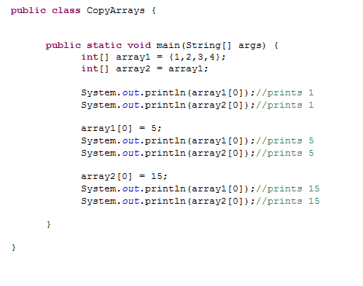
Copying Arrays

Slide 61
Copying Arrays
Using a loop:
int[] sourceArray = {2, 3, 1, 5, 10};
int[] targetArray = new int[sourceArray.length];
for (int i = 0; i < sourceArrays.length; i++)
targetArray[i] = sourceArray[i];

Slide 62
Passing Arrays to Methods
public static void printArray(int[] array) {
for (int i = 0; i < array.length; i++) {
System.out.print(array[i] + " ");
}
}
Invoke the method
int[] list = {3, 1, 2, 6, 4, 2};
printArray(list);

Slide 63
Pass By Value
Java uses pass by value to pass arguments to a method. There are important differences between passing a value of variables of primitive data types and passing arrays.
For a parameter of a primitive type value, the actual value is passed. Changing the value of the local parameter inside the method does not affect the value of the variable outside the method.
For a parameter of an array type, the value of the parameter contains a reference to an array; this reference is passed to the method. Any changes to the array that occur inside the method body will affect the original array that was passed as the argument.

Slide 64
Simple Example
public class Test {
public static void main(String[] args) {
int x = 1; // x represents an int value
int[] y = new int[10]; // y represents an array of int values
m(x, y); // Invoke m with arguments x and y
System.out.println("x is " + x);
System.out.println("y[0] is " + y[0]);
}
public static void m(int number, int[] numbers) {
number = 1001; // Assign a new value to number
numbers[0] = 5555; // Assign a new value to numbers[0]
}
}
After executing this, we get the following output.
x is 1
y[0] is 5555

Slide 65
Exercise 3b

Slide 66
Assignment #3

Slide 67
Multi-Dimensional Arrays (7)
We know Java can handle normal arrays, but what about two-dimensional arrays?
Consider a table or matrix.
5 | 3 | 7
6 | 4 | 8
4 | 5 | 56
5 | 6 | 6

Slide 68
Declare/Create 2-dimensional Arrays
// Declare array ref var
dataType[][] refVar;
// Create array and assign its reference to variable
refVar = new dataType[10][10];
// Combine declaration and creation in one statement
dataType[][] refVar = new dataType[10][10];
// Alternative syntax but not preferred.
dataType refVar[][] = new dataType[10][10];

Slide 69
2-Dimensional Arrays
Syntax
Declaration
int[][] matrix;
Initialization
matrix = new int[5][5];
Setting a single element in the array
matrix[2][1] = 6;
Think of the index of each subscript as the row and column number respectively.
Each row of the 2-dimensional array contains another array (Which represents the column values).
Remember, we begin iterating at 0, not 1.

Slide 70
Lengths of 2-dimensional Arrays.
int[][] array = {
{1, 2, 3},
{4, 5, 6},
{7, 8, 9},
{10, 11, 12}
};
array.length 4
array[0].length 3
array[1].length 3
array[2].length 3
array[3].length 3
array[4].length ArrayIndexOutOfBoundsException

Slide 71
Initializing a 2D Array
int[][] matrix = {
{1,2,3},
{4,5,6},
{7,8,9}
};
This is fine when we have all of the values for our 2d array; however, it is a bit of a cumbersome approach. Is there a faster way to go about doing this?

Slide 72
Filling a 2-Dimensional Array.
How will we go about filling a 2-dimensional array?
We have to keep in mind that a 2-dimensional array is built differently. A 2-dimensional array will have a certain amount of rows. Each of these rows will hold another array. Therefore, how should our for-loop structure change?

Slide 73
Creating Two-dimensional Arrays
int[][] values = new int[10][10];
for (int i = 0; i < values.length; i++)
for (int j = 0; j < values[i].length; j++)
values[i][j] = (int)(Math.random() * 1000);

Slide 74
How would we go about printing the array we made in the last example?
for (int i = 0; i < values.length; i++) {
for (int j = 0; j < values[i].length; j++) {
System.out.print(values[i][j] + “ “);
}
System.out.println();
}

Slide 75
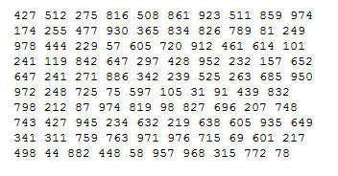
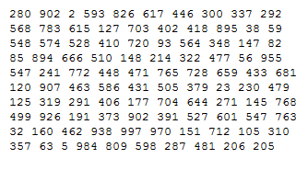
Demoing these Last Two Examples.

Slide 76
Passing 2D Arrays to Methods.
public static void printArray(int[][] values) {
for (int i = 0; i < values.length; i++) {
for (int j = 0; j < values[i].length; j++) {
System.out.print(values[i][j] + “ “);
}
System.out.println();
}
}
int[][] intArray = new int[10][10];
printArray(intArray);

Slide 77
Multi-Dimensional Arrays
We’ve solely been talking about 2D arrays to this point.
Java also has the capacity to create and maintain N-dimensional arrays
where N is an integer greater than 2.
Essentially no bound
The only bound is our own capacity to understand and maintain these giant arrays.
UPDATED: The language of the JVM indicates that there is an actual limit of 255 dimensions to an array (although I have never tested myself).

Slide 78
Multi-Dimensional Arrays
How do we ‘think’ about N-Dimensional arrays?
Recall that a 2-dimensional array was an array of 1-dimensional arrays.
We simply take the next step.
A 3-dimensional array is an array of 2-dimensional arrays.
A 4-dimensional array is an array of 3-dimensional arrays.
An N-dimensional array is an array of [N-1]-dimensional arrays.
Obviously, this becomes difficult rather quickly.

Slide 79
3-Dimensional Array (pg. 277)
The highest we’ll go in this class is 3-dimensional arrays.
Say we want to create a 3D array to store students’ exam scores. Let’s say there are 6 students. Each student took 5 exams. Each exam had 2 components (Multiple-choice and essay).
How would this declaration and initialization look?

Slide 80
3-Dimensional Array (pg. 277)
double[][][] scores = {
{{7.5, 20.5}, {9.0, 22.5}, {15, 33.5}, {13, 21.5}, {15, 2.5}},
{{4.5, 21.5}, {9.0, 22.5}, {15, 34.5}, {12, 20.5}, {14, 9.5}},
{{6.5, 30.5}, {9.4, 10.5}, {11, 33.5}, {11, 23.5}, {10, 2.5}},
{{6.5, 23.5}, {9.4, 32.5}, {13, 34.5}, {11, 20.5}, {16, 7.5}},
{{8.5, 26.5}, {9.4, 52.5}, {13, 36.5}, {13, 24.5}, {16, 2.5}},
{{9.5, 20.5}, {9.4, 42.5}, {13, 31.5}, {12, 20.5}, {16, 6.5}}};

